Slide 1
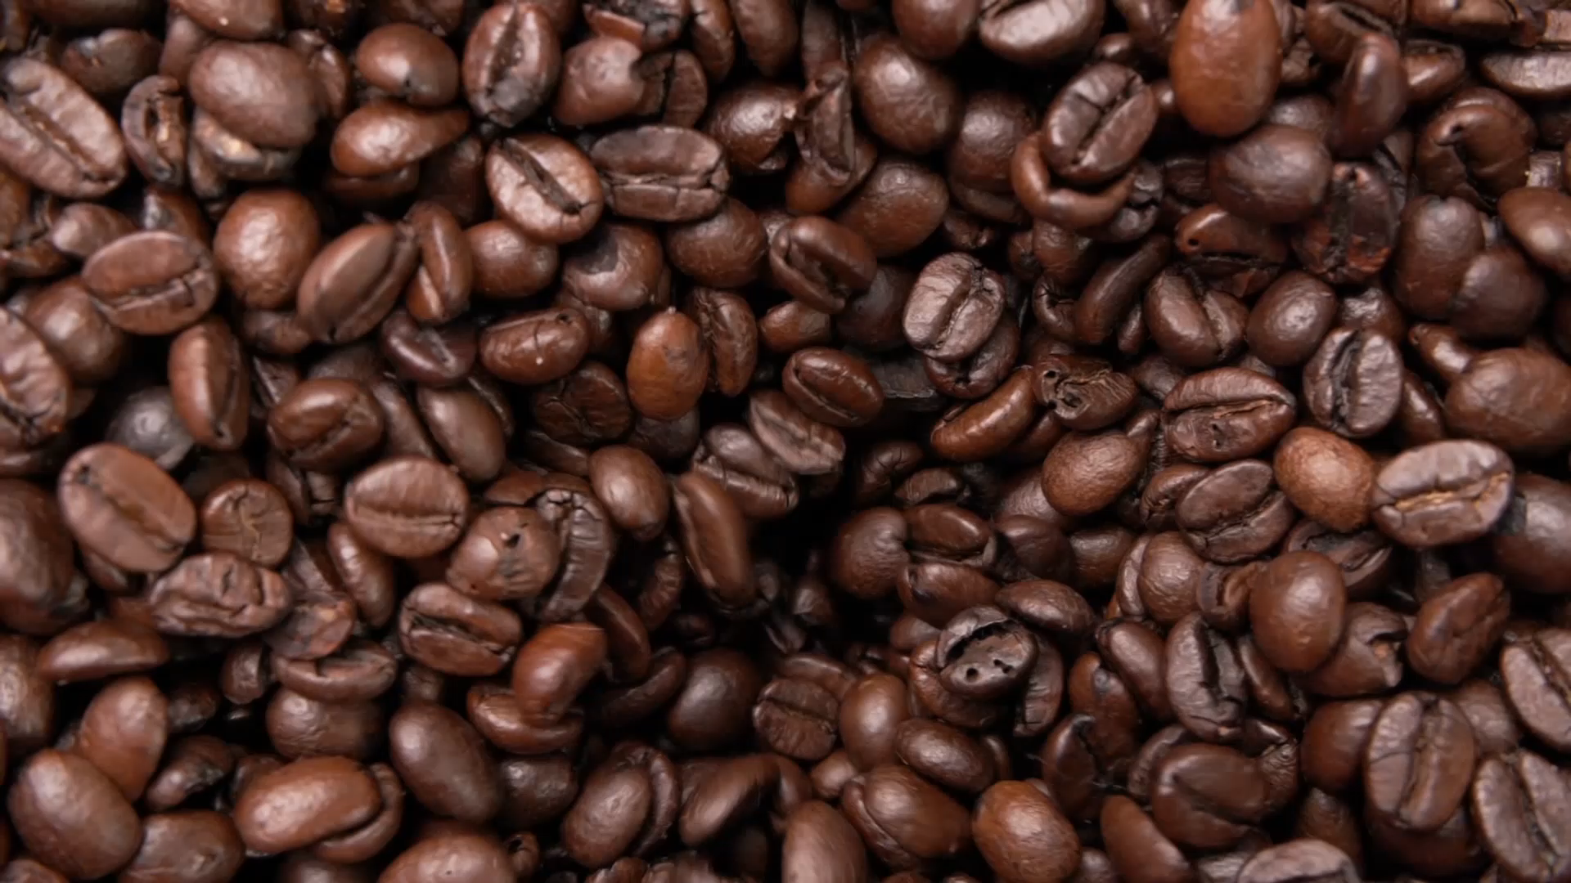
Nutritional Facts of Starbucks Menu
by: Emma Mukuri Maka

Slide 2

QUESTION
What are the most popular Starbucks menu items, and how do their nutritional profiles compare?

Slide 3

Most popular drinks
Starbucks TOP 3:
Iced Espresso Classics - Vanilla Latte
Iced Espresso Classics - Caffe Mocha
Iced Espresso Classics - Caramel Macchiato

Slide 4
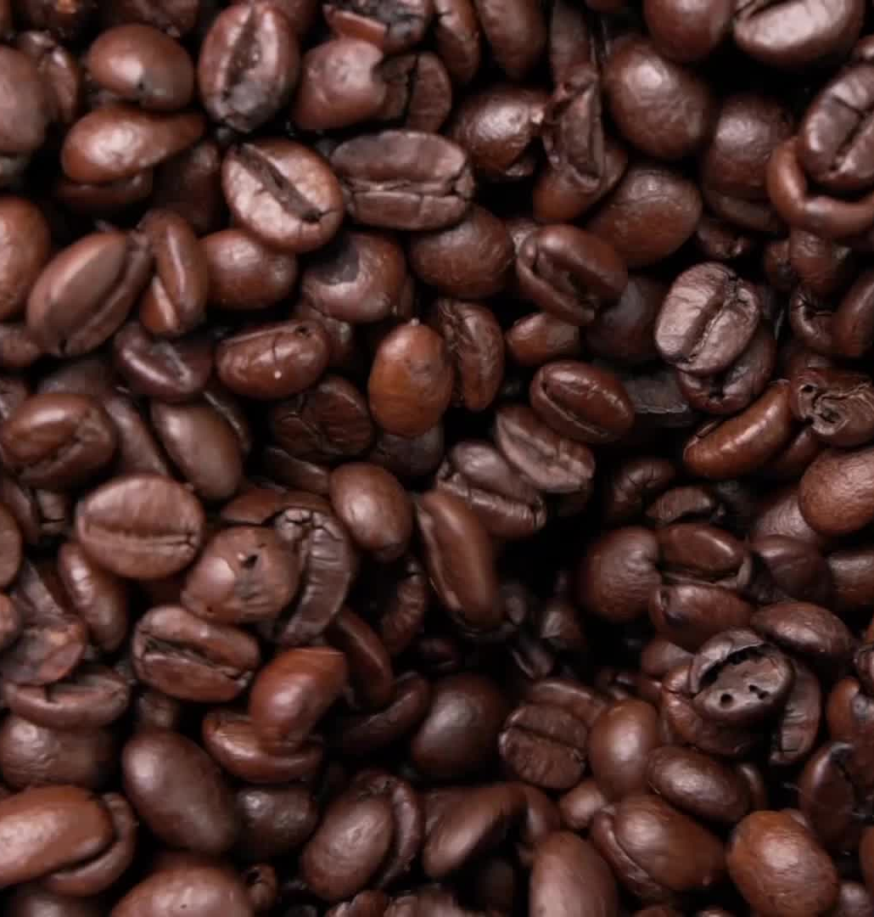
Nutritional facts of TOP 3
Iced Espresso Classics - Vanilla Latte
Calories:130
Fat (g):2.5
Carb(g):21
Fiber (g):0
Protein:5
Sodium:65
Iced Espresso Classics - Caffe Mocha
Calories:140
Fat (g): 2.5
Carb(g):23
Fiber (g):0
Protein:5
Sodium:90
Iced Espresso Classics - Caramel Macchiato
Calories:130
Fat (g): 2.5
Carb(g):21
Fiber (g):0
Protein:5
Sodium:65
All 3 have a caffeine intake of 75-150 mg.
Other drinks tend to have a much lower or much higher mg of caffeine.

Slide 5
Visualization

Slide 6
Other drinks from the menu have either much higher or much lower calories and the rest of the nutritional components have varying ranges.

Slide 7

FACT
A healthy adult should consume up to 400 mg of caffeine a day, while most adults tend to have more then 1 cup per day.

Slide 8
Conclusion
Seeing that most of the nutritional facts and weights are quite similar, as well as the amount of caffeine I can conclude that the amount of caffeine in each drink is the reason people tend to stick or go back to these drinks.

